Slide 1
Sales Performance Dashboard
Power BI Analysis Kavitha Balasubramaniam

Slide 2
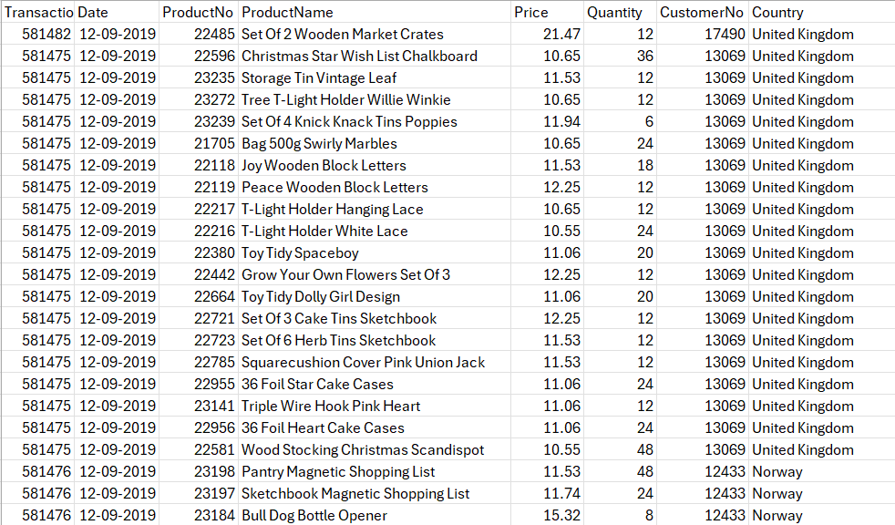
Dataset Overview
Dataset contains 54,000+ sales records.
Key attributes include: Date, ProductNo, ProductName, Price, Quantity, CustomerNo, and Country.
Captures transactional-level data across various countries.
Used to analyze sales trends, customer activity, and product performance.

Slide 3
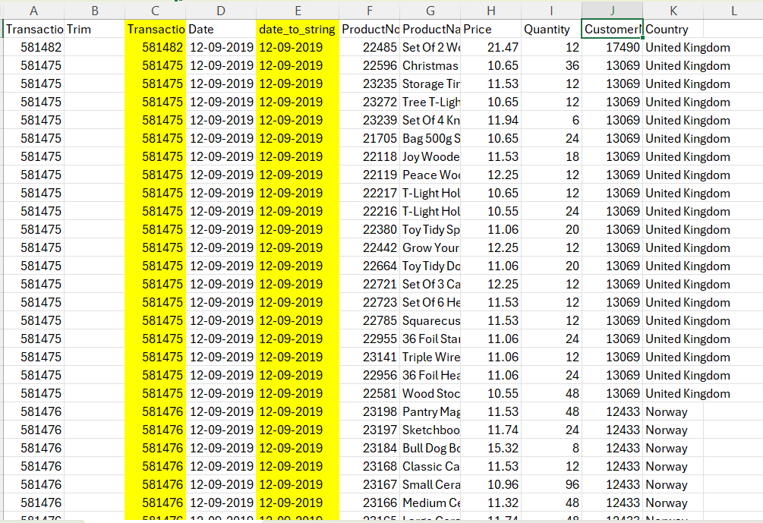
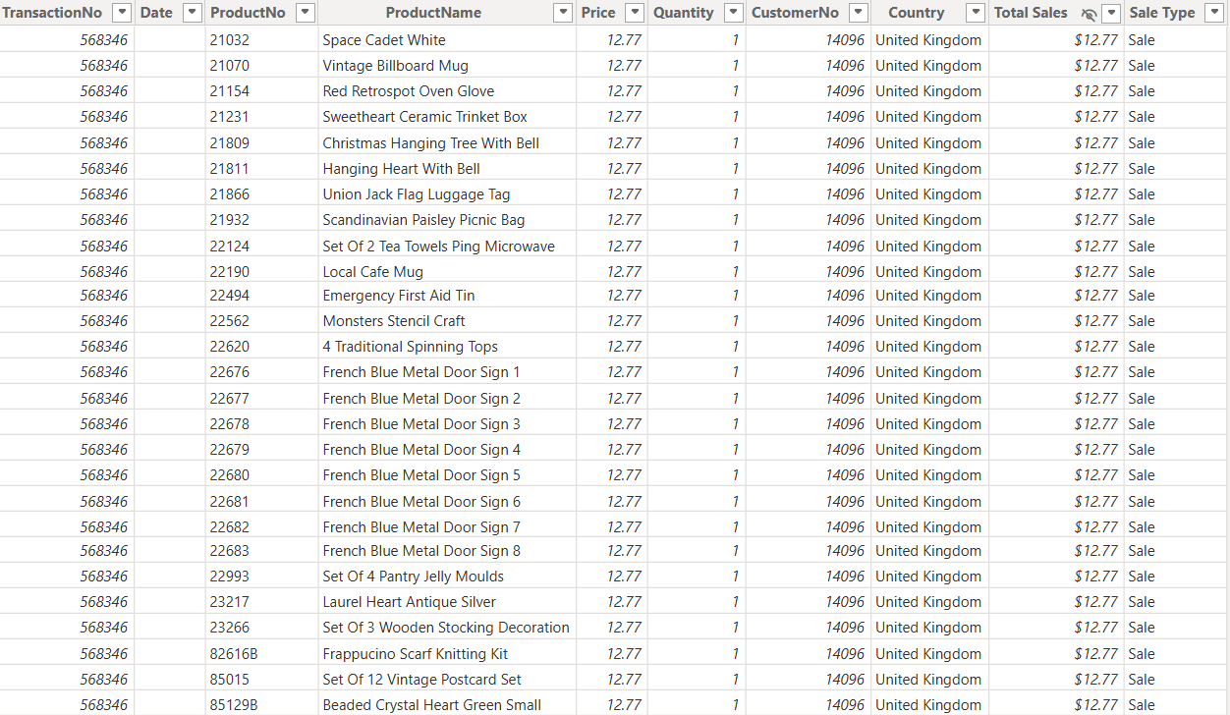
Data Cleaning Process
Raw Data
Cleansed Data

Slide 4
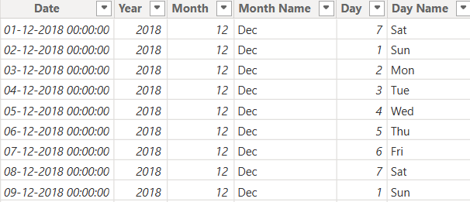
Data Cleaning Process
Standardized inconsistent date formats (MM/DD/YYYY, DD-MM-YYYY).
Replaced empty or missing values using fallback columns (e.g., Quantity from second column).
Ensured Quantity values were positive and valid for transactional data.
Created a proper Date table for time intelligence functions.

Slide 5
DAX Functions
Date Intelligence:
Created Year, Month, and Day columns from the date field for flexible time-based analysis and filtering.
Built a Date table using the CALENDAR function to support time intelligence calculations.
Sales Classification:
Defined a Sale Type column using an IF condition to distinguish between normal sales and returns (based on negative quantity).
Key Metrics:
Total Customers: Counted unique customers using DISTINCTCOUNT.
Total Quantity: Summed the Quantity field to track volume sold.
Total Sales: Used SUMX to calculate revenue by multiplying Price × Quantity for each row.
Transaction Count: Captured the number of distinct transactions to understand sales volume.

Slide 6
DAX Functions
Year = YEAR('Date'[Date])
Month = MONTH('Date'[Date])
Day = WEEKDAY('Date'[Date])
Date = CALENDAR(MIN ('Sales Transaction_cleansed'[Date]),MAX('SalesTransaction_cleansed'[Date]))
Sale Type = IF('Sales Transaction_cleansed'[Quantity]<0,"Return","Sale")
Total Customers = DISTINCTCOUNT('Sales Transaction_cleansed'[CustomerNo])
Total Quantity = SUM('Sales Transaction_cleansed'[Quantity])
Total_Sales = SUMX('Sales Transaction_cleansed','Sales Transaction_cleansed'[Quantity]*'Sales Transaction_cleansed'[Price])
Transaction Count = DISTINCTCOUNT('Sales Transaction_cleansed'[TransactionNo])

Slide 7
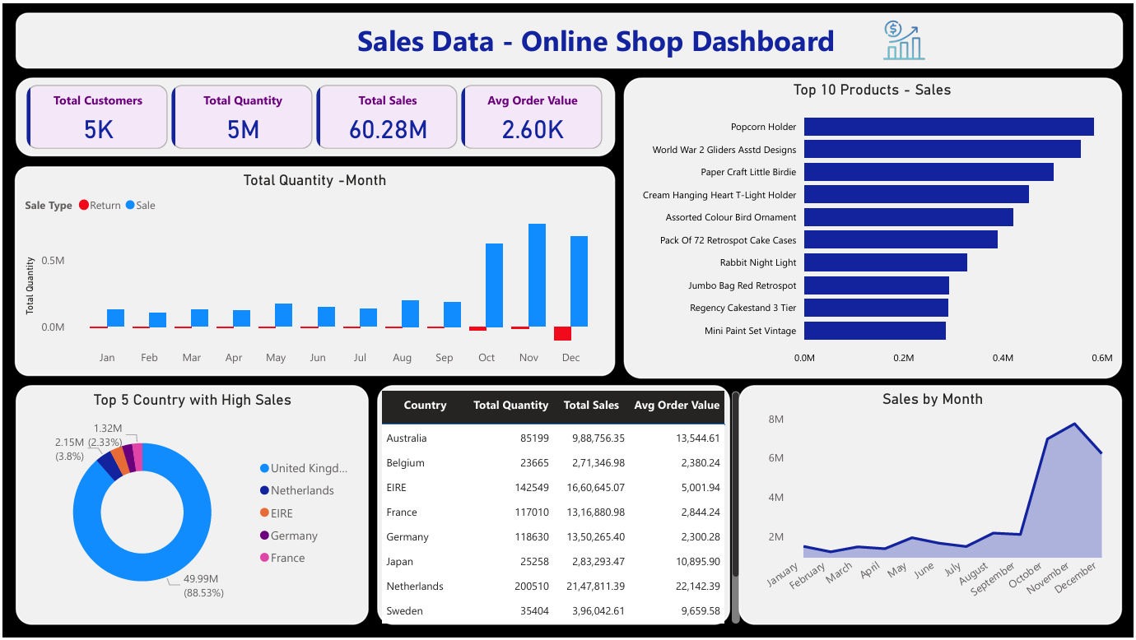
Dashboard Overview

Slide 8
Key Insights & Recommendations
Top 5 products contribute to over 40% of total sales.
Sales peak observed in Q4 of each year; consider seasonal promotions.
UK has the highest average order value — prioritize marketing.
Recommend real-time monitoring using Power BI for agile decision-making.

Slide 9
Conclusion
The dashboard offers a clear, data-driven view of sales performance across products, customers, and regions.
Patterns in sales volume, customer behavior, and seasonality can guide strategic marketing and inventory decisions.
Identifying high-performing products and regions helps prioritize business investments and promotional efforts.

Slide 10

Kavitha Balasubramaniam
12-05-2025

